Slide 1

Computer Operating Systems BLG 312E Week-11
Prof. Dr. Kemal Bıçakcı

Slide 2
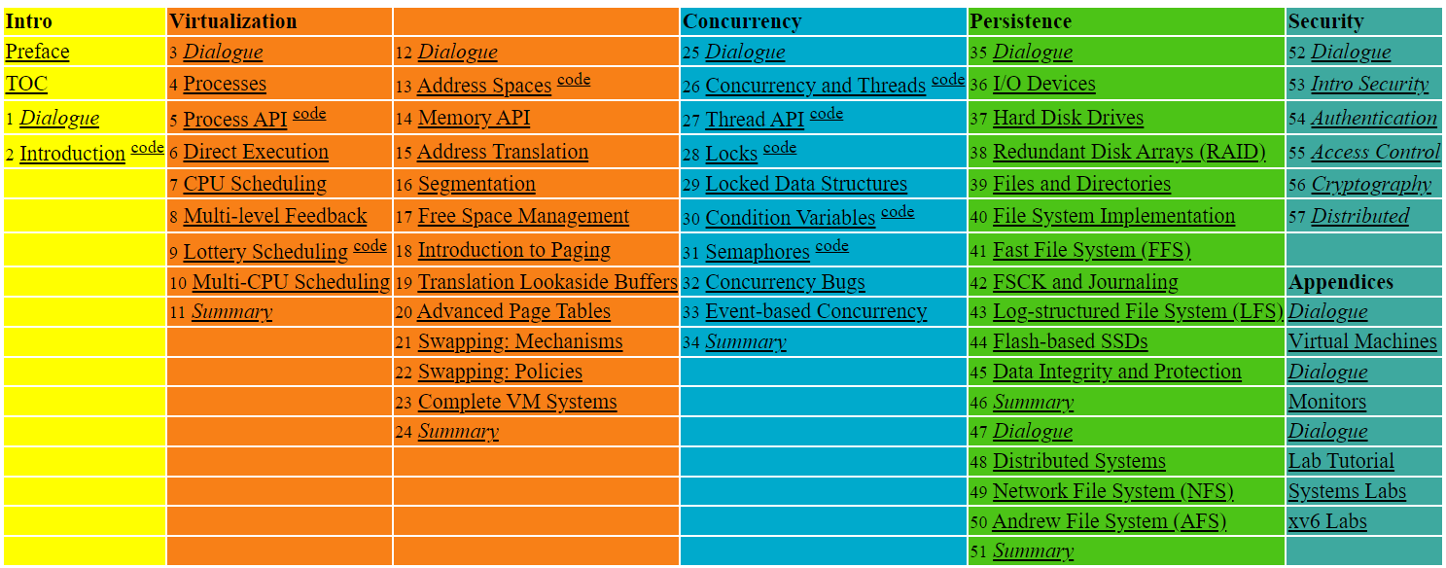

Slide 3
36. I/O Devices
Operating System: Three Easy Pieces

Slide 4
I/O Devices
I/O is critical to computer systems.
Clearly, for computer systems to be interesting, both input and output are required.
Issues:
How should I/O be integrated into systems?
What are the general mechanisms?
How can we make them efficiently?

Slide 5
System Architecture
CPU
Memory
Memory Bus
(proprietary)
General I/O Bus
(e.g., PCI)
Graphics
Peripheral I/O Bus
(e.g., SCSI, SATA, USB)
Prototypical System Architecture
CPU is attached to the main memory of the system via some kind of memory bus. Some devices are connected to the system via a general I/O bus.
Even lower down are one or more of what we call a peripheral bus.

Slide 6
I/O Architecture
Buses
Data paths that provides to enable information between CPU(s), RAM, and I/O devices.
I/O bus
Data path that connects a CPU to an I/O device.
I/O bus is connected to I/O device by three hardware components: I/O ports, interfaces and device controllers.

Slide 7
Canonical Device
Canonical Devices have two important components:
Hardware interface allows the system software to control its operation.
Internals which is implementation specific.
Registers:
Status
Command
Data
interface
Micro-controller(CPU)
Memory (DRAM or SRAM or both)
Other Hardware-specific Chips
internals
Canonical Device

Slide 8
Hardware Interface of a Canonical Device
status register
To see the current status of the device
command register
To tell the device to perform a certain task
data register
To pass data to the device, or get data from the device
By reading and writing above three registers,
the operating system can control device behavior.

Slide 9
Hardware Interface of a Canonical Device (Cont.)
Typical interaction example:
while ( STATUS == BUSY)
; //wait until device is not busy
write data to data register
write command to command register
Doing so starts the device and executes the command
while ( STATUS == BUSY)
; //wait until device is done with your request

Slide 10
Polling
Operating system waits until the device is ready by repeatedly reading the status register.
Positive aspect: simple and working.
However, it wastes CPU time just waiting for the device.
Switching to another ready process is better.
“waiting IO”
1
P
: task 1
: polling
CPU
.1 | 1 | 1 | 1 | 1 | p | p | p | p | p | 1 | 1 | 1 | 1 | 1
Disk
1 | 1 | 1 | 1 | 1
Diagram of CPU utilization by polling

Slide 11
Interrupts
Put the I/O request process to sleep and context switch to another.
When the device is finished, wake the process waiting for the I/O by interrupt.
Positive aspect: allow CPU and the disk properly utilized.
1
2
: task 1
: task 2
CPU
1 | 1 | 1 | 1 | 1 | 2 | 2 | 2 | 2 | 2 | 1 | 1 | 1 | 1 | 1
Disk
1 | 1 | 1 | 1 | 1
Diagram of CPU utilization by interrupt

Slide 12
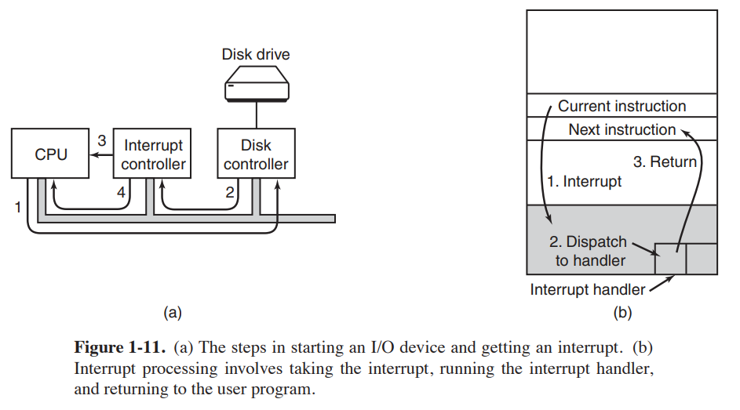
I/O by Interrupts
Tanenbaum, Modern Operating Systems 3 e, (c) 2008 Prentice-Hall, Inc. All rights reserved. 0-13-6006639

Slide 13
Polling vs. Interrupt
However, “interrupt is not always the best solution”
If, device performs very quickly, interrupt will “slow down” the system.
Because context switch is expensive (switching to another process)
If a device is fast → polling is better.
If it is slow → interrupt is better.

Slide 14
CPU is once again over-burdened
CPU wastes a lot of time to copy the a large chunk of data from memory to the device.
1
2
“over-burdened”
: task 1
: task 2
C
: copy data from memory
CPU
1 | 1 | 1 | 1 | C | C | C | 2 | 2 | 2 | 2 | 2 | 1 | 1 | 1
Disk
1 | 1 | 1 | 1 | 1
Diagram of CPU utilization

Slide 15
DMA (Direct Memory Access)
Copy data in memory without much CPU intervention by knowing “where the data lives in memory, how much data to copy”.
When completed, DMA raises an interrupt, I/O begins on Disk.
1
2
: task 1
: task 2
C
: copy data from memory
CPU
1 | 1 | 1 | 1 | 2 | 2 | 2 | 2 | 2 | 2 | 2 | 2 | 1 | 1 | 1
DMA
C | C | C
Disk
1 | 1 | 1 | 1 | 1
Diagram of CPU utilization by DMA

Slide 16
Device Interaction
How the OS communicates with the device?
Solutions
I/O instructions: a way for the OS to send data to specific device registers.
E.g., in and out instructions on x86
memory-mapped I/O
Device registers available as if they were memory locations.
The OS load (to read) or store (to write) to the device instead of main memory.

Slide 17
Device Interaction (Cont.)
How the OS interact with different specific interfaces?
E.g., We’d like to build a file system that works on top of SCSI disks, IDE disks, USB keychain drivers, and so on.
Solutions: Abstraction
Abstraction encapsulates any specifics of device interaction.

Slide 18
File System Abstraction
File system is completely oblivious to the specifics of which disk class it is using.
It issues block read and write request to the generic block layer.
Application
user
POSIX API [open, read, write, close, etc]
File System
kernel
Generic Block Interface [block read/write]
Generic Block Layer
Specific Block Interface [protocol-specific read/write]
Device Driver [SCSI, ATA, etc]
The File System Stack

Slide 19
Problem of Abstraction
If there is a device having special capabilities, these capabilities will go unused in the generic interface layer.

Slide 20
Device Drivers
Over 70% of OS code is found in device drivers.
Any device drivers are needed because you might plug it to your system.
They are primary contributor to kernel crashes, making more bugs.

Slide 21
A Simple IDE Disk Driver
Four types of register
Control, command block, status and error
in and out I/O instructions

Slide 22
A Simple IDE Disk Driver (Cont’d)
Control Register:
Address 0x3F6 = 0x80 (0000 1RE0): R=reset, E=0 means "enable interrupt”
Command Block Registers:
Address 0x1F0 = Data Port
Address 0x1F1 = Error
Address 0x1F2 = Sector Count
Address 0x1F3 = LBA low byte
Address 0x1F4 = LBA mid byte
Address 0x1F5 = LBA hi byte
Address 0x1F6 = 1B1D TOP4LBA: B=LBA, D=drive
Address 0x1F7 = Command/status

Slide 23
A Simple IDE Disk Driver (Cont’d)
Status Register (Address 0x1F7):
7 6 5 4 3 2 1 0
BUSY READY FAULT SEEK DRQ CORR IDDEX ERROR
Error Register (Address 0x1F1): (check when Status ERROR==1):
7 6 5 4 3 2 1 0
BBK UNC MC IDNF MCR ABRT T0NF AMNF
BBK = Bad Block
UNC = Uncorrectable data error
MC = Media Changed
IDNF = ID mark Not Found
MCR = Media Change Requested
ABRT = Command aborted
T0NF = Track 0 Not Found
AMNF = Address Mark Not Found

Slide 24
A Simple IDE Disk Driver (Cont’d)
Wait for drive to be ready. Read Status Register (0x1F7) until drive is not busy and READY.
Write parameters to command registers. Write the sector count, logical block address (LBA) of the sectors to be accessed, and drive number (master=0x00 or slave=0x10, as IDE permits just two drives) to command registers (0x1F2-0x1F6).
Start the I/O. by issuing read/write to command register. Write READ—WRITE command to command register (0x1F7).
Data transfer (for writes): Wait until drive status is READY and DRQ (drive request for data); write data to data port.
Handle interrupts. In the simplest case, handle an interrupt for each sector transferred; more complex approaches allow batching and thus one final interrupt when the entire transfer is complete.
Error handling. After each operation, read the status register. If the ERROR bit is on, read the error register for details.

Slide 25
A Simple IDE Disk Driver (xv6 – Main Functions)
void ide_rw(struct buf *b) {}
static void ide_start_request(struct buf *b) {}
static int ide_wait_ready() {}
void ide_intr() {}

Slide 26
A Simple IDE Disk Driver (Cont’d)
void ide_rw(struct buf *b) {
acquire(&ide_lock);
for (struct buf **pp = &ide_queue; *pp; pp=&(*pp)>qnext)
; // walk queue
*pp = b; // add request to end
if (ide_queue == b) // if q is empty
ide_start_request(b); // send req to disk
while ((b->flags & (B_VALID|B_DIRTY)) != B_VALID)
sleep(b, &ide_lock); // wait for completion
release(&ide_lock);
}

Slide 27
A Simple IDE Disk Driver (xv6)
static void ide_start_request(struct buf *b) {
ide_wait_ready();
outb(0x3f6, 0); // generate interrupt
outb(0x1f2, 1); // how many sectors?
outb(0x1f3, b->sector & 0xff); // LBA goes here ...
outb(0x1f4, (b->sector >> 8) & 0xff); // ... and here
outb(0x1f5, (b->sector >> 16) & 0xff); // ... and here!
outb(0x1f6, 0xe0 | ((b->dev&1)<<4) | ((b->sector>>24)&0x0f));
if(b->flags & B_DIRTY){
outb(0x1f7, IDE_CMD_WRITE); // this is a WRITE
outsl(0x1f0, b->data, 512/4); // transfer data too!
} else {
outb(0x1f7, IDE_CMD_READ); // this is a READ (no data)
}
}

Slide 28
A Simple IDE Disk Driver (xv6)
static int ide_wait_ready() {
while (((int r = inb(0x1f7)) & IDE_BSY) ||
!(r & IDE_DRDY))
; // loop until drive isn’t busy
}

Slide 29
A Simple IDE Disk Driver (Cont’d)
void ide_intr() {
struct buf *b;
acquire(&ide_lock);
if (!(b->flags & B_DIRTY) && ide_wait_ready(1) >= 0)
insl(0x1f0, b->data, 512/4); // if READ: get data
b->flags |= B_VALID;
b->flags &= ˜B_DIRTY;
wakeup(b); // wake waiting process
if ((ide_queue = b->qnext) != 0) // start next request
ide_start_request(ide_queue); // (if one exists)
release(&ide_lock);
}

Slide 30
Explanation
ide_rw queues a request (if there are others pending), or issues it directly to the disk (via ide_start_request).
In either case, the routine waits for the request to complete and the calling process is put to sleep.
ide_start_request is used to send a request (and perhaps data, in the case of a write) to the disk; the in and out x86 instructions are called to read and write device registers, respectively.
The start request routine uses the third function, ide_wait_ready, to ensure the drive is ready before issuing a request to it.
Finally, ide_intr() is invoked when an interrupt takes place; it reads data from the device (if the request is a read, not a write), wakes the process waiting for the I/O to complete, and (if there are more requests in the I/O queue), launches the next I/O via ide_start_request.

Slide 31
37. Hard Disk Drives
Operating System: Three Easy Pieces

Slide 32
Hard Disk Driver
Hard disk drivers have been the main form of persistent data storage in computer systems for decades.
HDD vs. SSD?
The drive consists of a large number of sectors (512-byte blocks).
Address Space :
We can view the disk with n sectors as an array of sectors; 0 to n-1.

Slide 33
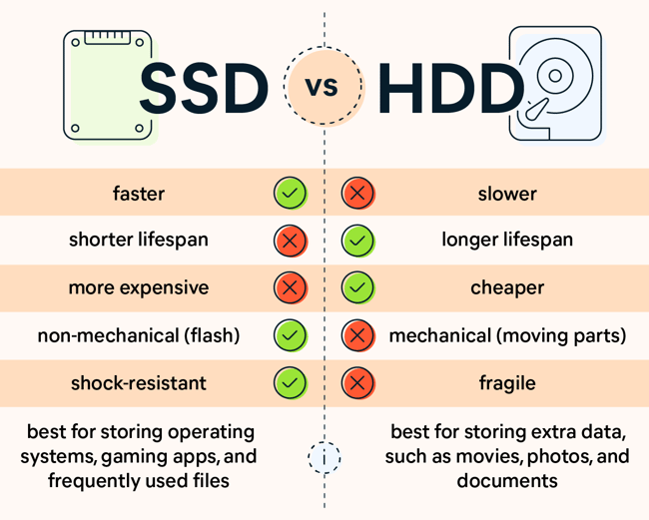

Slide 34
Interface
The only guarantee is that a single 512-byte write is atomic.
Multi-sector operations are possible.
Many file systems read or write 4KB at a time.
Torn write:
If an untimely power loss occurs, only a portion of a larger write may complete.
Accessing blocks in a contiguous chunk is the fastest access mode.
A sequential read or write
Much faster than any more random access pattern.

Slide 35
Basic Geometry
spindle
Platter (Aluminum coated with a thin magnetic layer)
A circular hard surface
Data is stored persistently by inducing magnetic changes to it.
Each platter has 2 sides, each of which is called a surface.
A Disk with Just A Single Track (12 sectors)

Slide 36
Basic Geometry (Cont.)
Spindle
Spindle is connected to a motor that spins the platters around.
The rate of rotations is measured in RPM (Rotations Per Minute).
Typical modern values: 7,200 RPM to 15,000 RPM.
E.g., 10000 RPM : A single rotation takes about 6 ms.
Track
Concentric circles of sectors
Data is encoded on each surface in a track.
A single surface contains many thousands of tracks.

Slide 37
A Simple Disk Drive
Rotates this way
Disk head (One head per surface of the drive)
The process of reading and writing is accomplished by the disk head.
Attached to a single disk arm, which moves across the surface.
head
spindle
arm
A Single Track Plus A Head

Slide 38
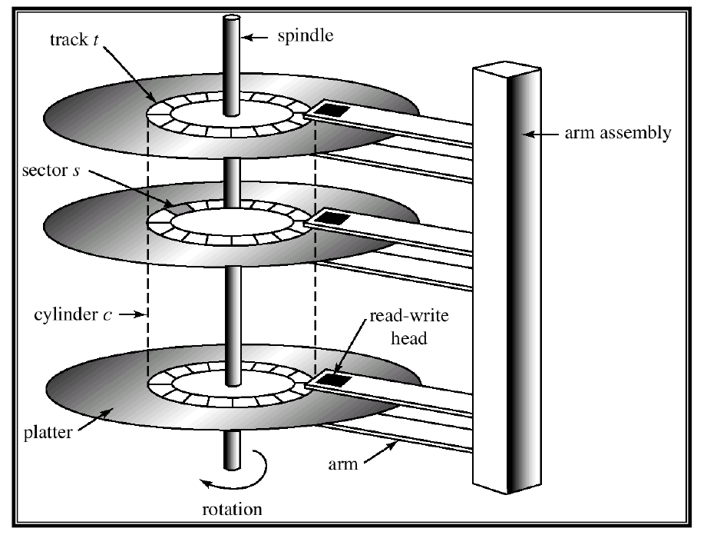
Example of a Disk

Slide 39

Single-track Latency: The Rotational Delay
Rotates this way
Rotational delay: Time for the desired sector to rotate
E.g., Full rotational delay is R and we start at sector 6
Read sector 0: Rotational delay = $\frac{R}{2}$
Read sector 5: Rotational delay = R-1 (worst case)
head
spindle
arm
A Single Track Plus A Head

Slide 40
Multiple Tracks: Seek Time
Rotates this way
Rotates this way
Remaining rotation
seek
spindle
spindle
Three Tracks Plus A Head (Right: With Seek)
(e.g., read to sector 11)
Seek: Move the disk arm to the correct track
Seek time: Time to move head to the track containing the desired sector.
One of the most costly disk operations.

Slide 41
Phases of Seek
Acceleration → Coasting → Deceleration → Settling
Acceleration: The disk arm gets moving.
Coasting: The arm is moving at full speed.
Deceleration: The arm slows down.
Settling: The head is carefully positioned over the correct track.
The settling time is often quite significant, e.g., 0.5 to 2ms.

Slide 42
Transfer
The final phase of I/O
Data is either read from or written to the surface.
Complete I/O time:
Seek
Waiting for the rotational delay
Transfer

Slide 43
Track Skew
Make sure that sequential reads can be properly serviced even when crossing track boundaries.
Without track skew, the head would be moved to the next track but the desired next block would have already rotated under the head.
Rotates this way
9
8
19
10
18
20
7
28
29
30
11
17
21
27
31
Spindle
6
16
26
32
22
0
25
33
5
15
24
34
23
35
1
14
12
4
13
2
3
Three Tracks: Track Skew Of 2

Slide 44
Cache (Track Buffer)
Hold data read from or written to the disk
Allow the drive to quickly respond to requests.
Small amount of memory (usually around 8 or 16 MB)

Slide 45
Write on cache
Write back (Immediate reporting)
Acknowledge a write has been completed when it has put the data in its memory.
faster but dangerous
Write through
Acknowledge a write has been completed after the write has actually been written to disk.

Slide 46

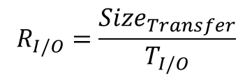
I/O Time: Doing The Math
I/O time ($T_{I/O}$):
The rate of I/O ($R_{I/O}$):
$$T_{I/O}=T_{seek}+T_{rotation}+T_{transfer}$$
$$R_{I/O}=\frac{{Size}_{Transfer}}{T_{I/O}}$$
 | Cheetah 15K.5 | Barracuda
Capacity | 300 GB | 1 TB
RPM | 15,000 | 7,200
Average Seek | 4 ms | 9 ms
Max Transfer | 125 MB/s | 105 MB/s
Platters | 4 | 4
Cache | 16 MB | 16/32 MB
Connects Via | SCSI | SATA
Disk Drive Specs: SCSI Versus SATA

Slide 47
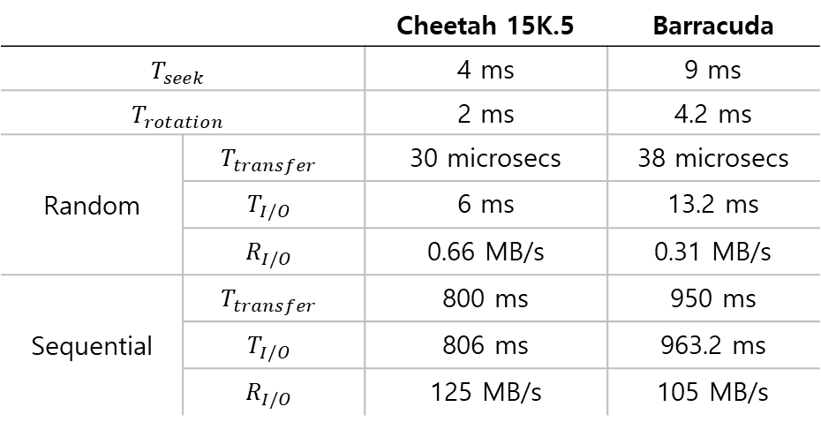
I/O Time Example
Random workload: Issue 4KB read to random locations on the disk
Sequential workload: Read 100MB consecutively from the disk
 |  | Cheetah 15K.5 | Barracuda
$$T_{seek}$$ |  | 4 ms | 9 ms
$$T_{rotation}$$ |  | 2 ms | 4.2 ms
Random | $$T_{transfer}$$ | 30 microsecs | 38 microsecs
 | $$T_{I/O}$$ | 6 ms | 13.2 ms
 | $$R_{I/O}$$ | 0.66 MB/s | 0.31 MB/s
Sequential | $$T_{transfer}$$ | 800 ms | 950 ms
 | $$T_{I/O}$$ | 806 ms | 963.2 ms
 | $$R_{I/O}$$ | 125 MB/s | 105 MB/s
Disk Drive Performance: SCSI Versus SATA
There is a huge gap in drive performance
between random and sequential workloads

Slide 48
Disk Scheduling
Disk Scheduler decides which I/O request to schedule next.
SSTF (Shortest Seek Time First)
Order the queue of I/O request by track
Pick requests on the nearest track to complete first
Rotates this way
9
8
21
10
20
22
7
32
33
34
11
19
23
SSTF: Scheduling Request 21 and 2
issue the request to 21 → issue the request to 2
31
35
Spindle
6
18
30
24
12
0
29
25
5
17
28
26
13
27
1
16
14
4
15
2
3

Slide 49
SSTF is not a panacea.
Problem 1: The drive geometry is not available to the host OS
Solution: OS can simply implement Nearest-block-first (NBF)
Problem 2: Starvation
If there were a steady stream of request to the inner track, request to other tracks would then be ignored completely.

Slide 50
Elevator (a.k.a. SCAN or C-SCAN)
Move across the disk servicing requests in order across the tracks.
Sweep: A single pass across the disk
If a request comes for a block on a track that has already been services on this sweep of the disk, it is queued until the next sweep.
F-SCAN
Freeze the queue to be serviced when it is doing a sweep
Avoid starvation of far-away requests
C-SCAN (Circular SCAN)
Sweep from outer-to-inner, and then inner-to-outer, etc.

Slide 51
How to account for Disk rotation costs?
Rotates this way
9
8
21
10
If rotation is faster than seek : request 16 → request 8
If seek is faster than rotation : request 8 → request 16
20
22
7
32
33
34
11
19
23
31
35
Spindle
6
18
30
24
12
0
29
25
5
17
28
26
13
27
1
16
14
4
15
2
3
SSTF: Sometimes Not Good Enough
On modern drives, both seek and rotation are roughly equivalent:
Thus, SPTF (Shortest Positioning Time First) is useful.

Slide 52
I/O merging
Reduce the number of request sent to the disk and lower overhead
E.g., read blocks 33, then 8, then 34:
The scheduler merge the request for blocks 33 and 34 into a single two-block request.

